Slide 1
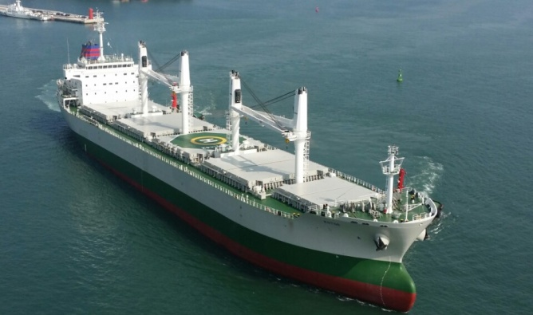
INTRODUCTION
KOREA YANASE TONGYEONG
SHIPYARD CO., LTD.
www. kyship.co.kr

Slide 2
CONTENTS
1
GENERAL INFORMATION
6 MAIN PRODUCTS
2
HISTORY
32K BULK CARRIER
17K OIL CHEMICAL TANKER
3
STATUS
12.8K OIL CHEMICAL TANKER
4
ORGANIZATION
3.4K OIL CHEMICAL TANKER
5
5
SHIP YARDS
7
BUILDING FACILITIES
TONG YEONG
8
PERFORMANCE RECORD
9
9
CERTIFICATE
10
Vision to the Future!

Slide 3
1. GENERAL INFORMATION
COMPANY NAME : KOREA YANASE TONGYEONG SHIPYARD
CHAIR MAN(CEO) : YOUNG-JUN. WOO
PRESIDENT(COO) :
ESTABLISHMENT : 15TH JULY, 2013
EMPLOYEES : 180 PERSONS (JAN. 2025)(MAIN OFFICE 30 / SUB-CONTRACTOR 150)
CAPITAL : 10 BILLION KRW
LOCATION :
- HEAD OFFICE
#64, MIDEODEOK-RO, JINJEON-MYEON, MASANHAPPO-GU, CHANGWON-CITY,
KYUNGSANGNAM-DO, KOREA
- TONG YEONG SHIPYARD
#48 ( DONAM-DONG), SEO SONG JEONG-GIL, TONGYEONG-CITY, KYUNGSANGNAM-DO, KOREA
TEL : 055-643-3060 / FAX : 055-643-3064
Vision to the Future!

Slide 4
2. HISTORY
JUL DELIVERED 65,000P STP BARGE
2024 JUL DELIVERED 3,500 DWT OIL TANKER
2021 DEC DELIVERED 24M WORK BOAT
2021 MAY DELIVERED 65M OSRV
2021 MAR DELIVERED 2,800 DWT CPP TANKER
2020 JAN DELIVERED 2,800 DWT CPP TANKER
2016 MAR DELIVERED 3,500 DWT OIL/ CHEMICAL TANKER
2015 MAR DELIVERED 7,000P BARGE
2014 NOV DELIVERED 32,000 DWT BULK CARRIER
2013 MAY ESTABLISHED KOREA YANASE TONGYEONG SHIPYARD CO., LTD.
2009 NOV EXPORT $400 MILLION DISTINGUISHED AWARD AND PRESIDENT’S AWARD
(KOREA INTERNATIONAL TRADE ASSOCIATION)
2001 MAY CHANGED THE COMPANY NANE TO SAMHO SHIPBUILD CO., LTD.
1994 JUN ESTABLISHED WITH THE COMPANY NAME OF HAEDONG SHIPYARD
Vision to the Future!

Slide 5
3. STATUS
YARD SCALE : 72,140m²
- TONGYEONG ( 72,140m²)
ANNUAL SHIPBUILDING CAPACITIS : 10 VESSELS
SIZE OF VESSEL : DWT 3,500 ~ 32,000 OIL / CHEMICAL TANKER
HANDY BULK CARRIER
BACKLOG OF ORDERS : ( 2 ) VESSELS ( 5K OIL TANKER)
PRINCIPLE EXPORTING COUNTRIES : GREECE, NORWAY, MONACO, EAST SOUTH ASIA ETC.
ANNUAL PRODUCTION CAPACITY
YEAR | 2025 | 2026 | 2027 | 2028 | 2029 | 2030
TON | 7,000 | 7,000 | 10,000 | 12,000 | 15,000 | 20,000
20,000 TON
30
15,000 TON
‘29
10,000 TON
‘27
‘28
7,000 TON
‘25
‘26
Vision to the Future!

Slide 6
4. ORGANIZATION
CEO
COO
Planning &
Audit
Shipsales
Production
QA / QC
Purchasing
Accounting
Administration
Contracting
General affairs
Planning &
Control
Hull
Machinery
Block
manufacturing
Sales engineering
Human
resource
Production
control
Hull block
management
Machinery
outfittings
Customer
supporting
Health &
Safety
Subcontractor
control
Hull
outfittings
Electric
outfittings
Warranty
Facility &
Utility
Production
engineering
Painting
Pipings
ERP
Precision
Vision to the Future!

Slide 7
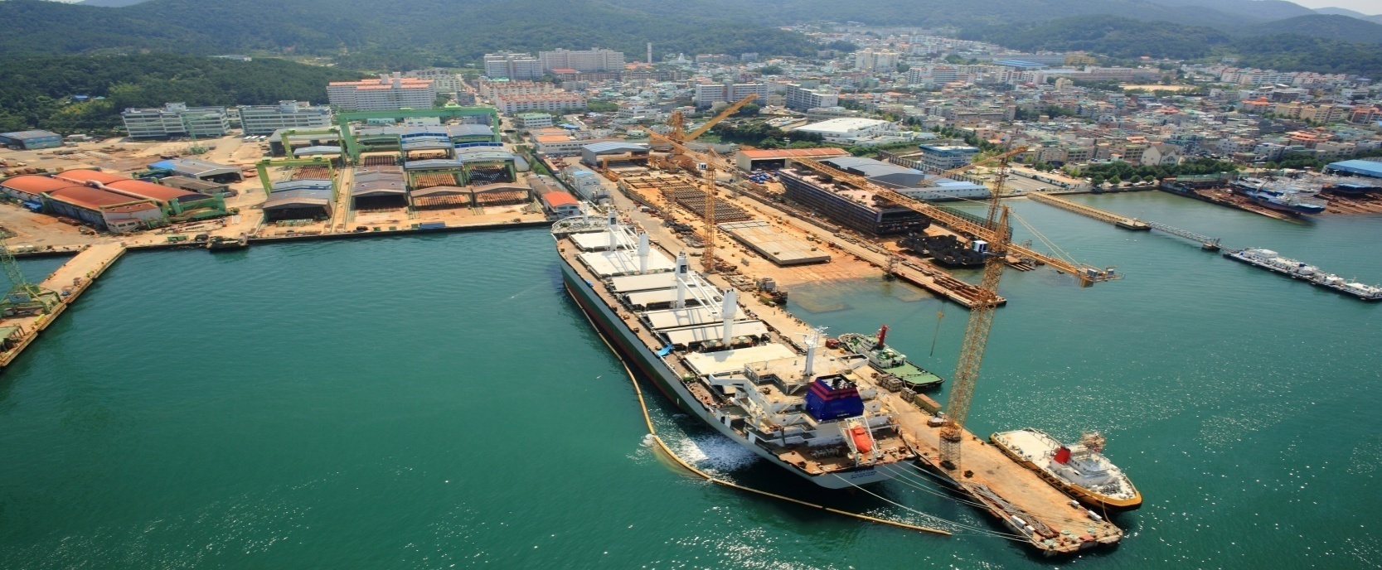
5. SHIP YARDS
TONG YEONG
BUILDING BERTH :
No. 1 SLIPWAY 175M x 33.6M (VESSEL UP TO 196M LENGTH x 36M BEAM)
No. 2 SLIPWAY 154M x 27.4M (VESSEL UP TO 180M LENGTH x 31M BEAM)
MAIN CRANE : 120TON JIB CRANE
OUTFITTING QUAY SIDE : 247M
TWO(2) PAINTING SHOPS AND ONE(1) BLASTING SHOP
Vision to the Future!

Slide 8
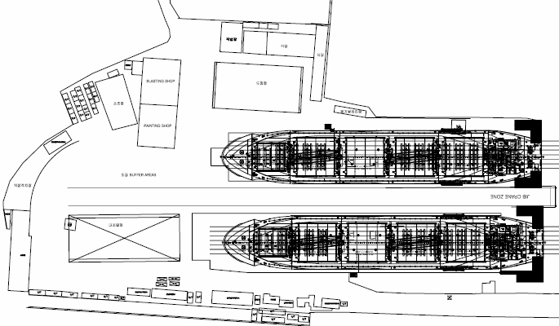
5-1. YARD DETAILS
TONG YEONG LAY-OUT
MAIN GATE
WORKSHOP
BLASTING SHOP
PAINT SHOP
ASSEMBLY
SHOP
PLACE FOR WASTE DISPOSAL
PAINT
SHOP
Berth No.2 (154m)
OUTFITTING
BUFFER AREA
OUTFITTING
YARDS
JIB CRANE ZONE
ASSEMBLY
SHOP
MAIN OFFICE
BUILDING
Berth No.1 (175m)
RESTAURANT
CRANE 120TON
T/C 12TON
HIGH PRESSURE
GAS STORAGE
COMPRESSOR ROOM
Outfitting Quay (247M)

Slide 9
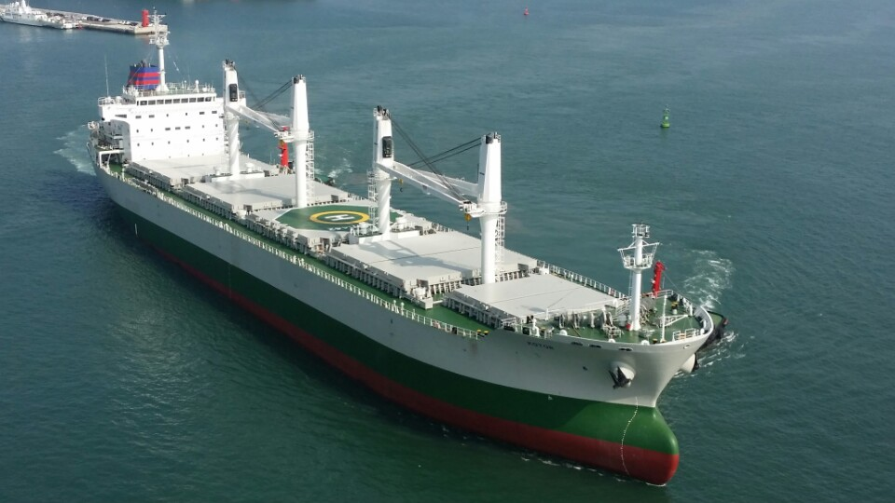
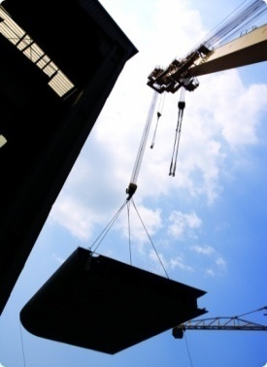
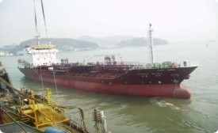
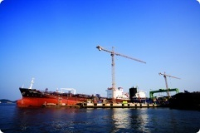
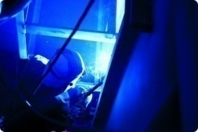
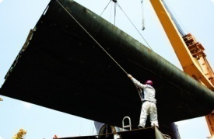
6. MAIN PRODUCTS
32K BULK CARRIER(DOUBLE SKIN)
● 180.34mⅹ30mⅹ14.8m (LⅹBⅹD)
● M/E : MAN B&W 6S46MC(MK-VII) 6,480kW
● 6 VESSELS DELIVERED
Vision to the Future!

Slide 10
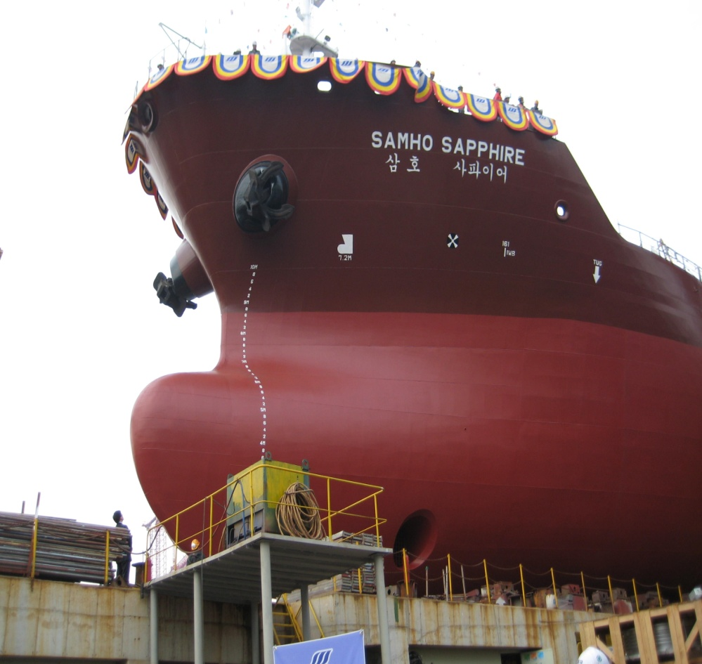
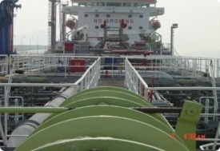
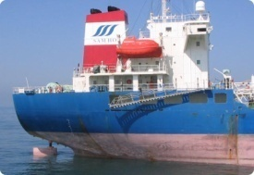
6. MAIN PRODUCTS
17K CHEMICAL TANKER(IMO II)
● 144mⅹ22mⅹ12m (LⅹBⅹD)
● M/E : MAN B&W 8S35MC(Mark7) 5,920kW
● 18 VESSELS DELIVERED
Vision to the Future!

Slide 11
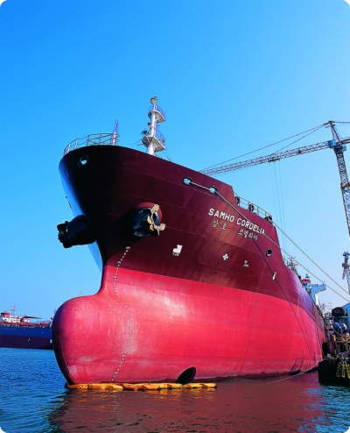
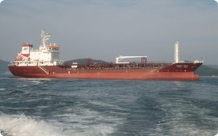
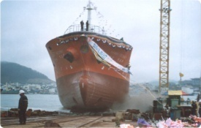
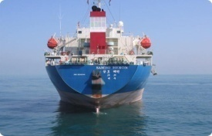
6. MAIN PRODUCTS
12.8K CHEMICAL TANKER(IMO II)
● 129.5mⅹ20.4mⅹ11.5m (LⅹBⅹD)
● M/E : MAN B&W 6S35MC 4,440 kW
● 31 VESSELS DELIVERED
Vision to the Future!

Slide 12
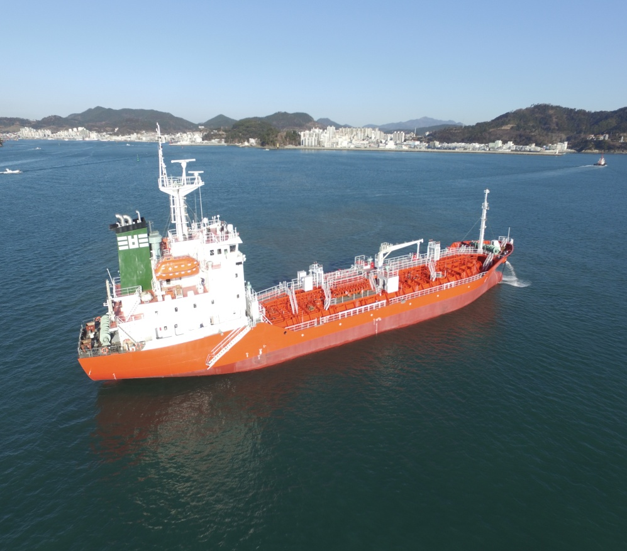
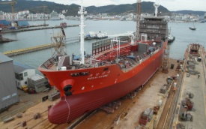
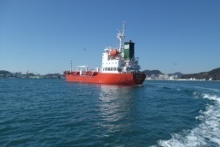
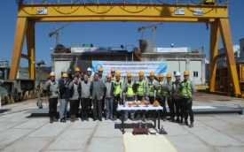
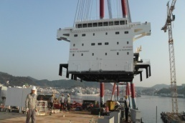
6. MAIN PRODUCTS
3.5K CHEMICAL TANKER(IMO II)
● 91.6m X 14.2m X 7.5m (LⅹBⅹD)
● M/E : 3,300PS X 225RPM
● 1 VESSELS DELIVERED
Vision to the Future!

Slide 13
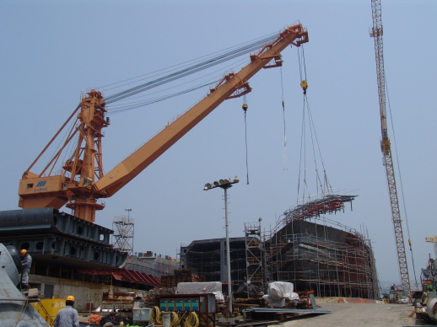
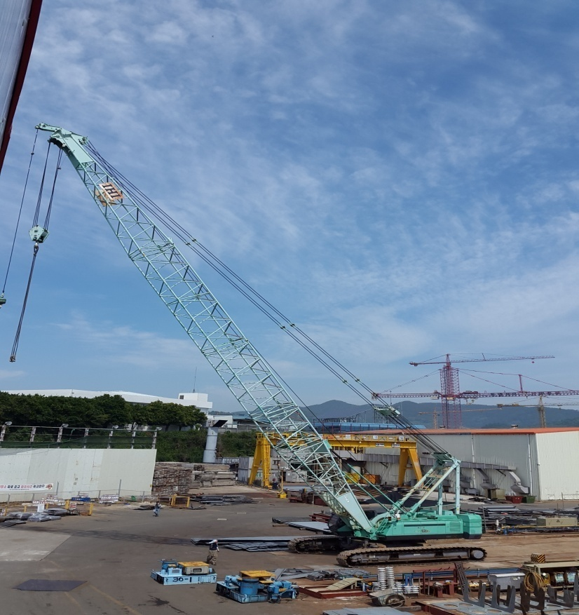
7. BUILDING FACILITY
JIB CRANE (120TON)
CRAWLER CRANE(120TON)
Vision to the Future!

Slide 14
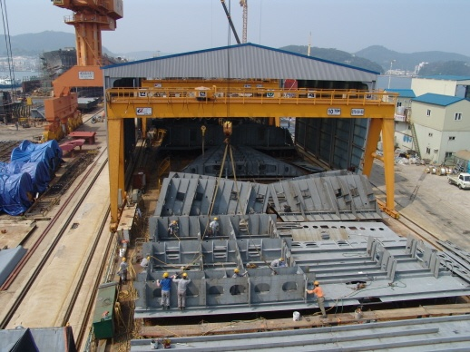
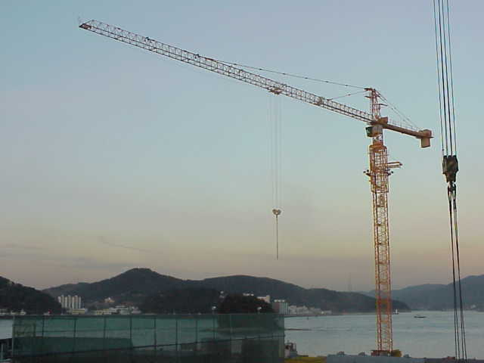
7. BUILDING FACILITY
GANTRY CRANE (10TON X 3)
TOWER CRANE(12 TON)
Vision to the Future!

Slide 15
8. Performance Record
NO | HULL NO | TYPE OF VESSEL | DWT | DELIVERY | BUYER | CLASS | FLAG
1 | HDS-1001 | TUG BOAT | 150 | AUG.1992 | NATIONAL MARITIME POLIC AGENCY | K.G | KOREA
2 | HDS-1002 | OIL & CHEMICAL TANKER(SUS TYPE 2) | 2,200 | Jan.1993 | JEIL SHIPPING | KR | KOREA
116 | KYTS-1228 | BULK CARRIER | 32,000 | DEC.2013 | YOESU MARINE | ABS | KOREA
117 | KYTS-1001 | BULK CARRIER | 32,000 | NOV.2014 | DABINOVIC SAM | ABS | KINGS TOWN
118 | KYTS-0000 | FLAT BARGE | 3,000P | DEC.2014 | KOREA YANASE | KR | KOREA
119 | KYTS-0000 | FLAT BARGE | 3,000P | JAN.2015 | KOREA YANASE | KR | KOREA
120 | KYTS-1003 | FLAT BARGE | 7,000 | FEB.2015 | KOREA YANASE | KR | KOREA
121 | KYTS-1002 | OIL & CHEMICAL TANKER | 3,500 | MAR.2016 | SAMBU SHIPPING | KR | KOREA
122 | KYTS-1004 | OIL TANKER | 2,800 | JAN.2020 | V.L ENTERPRISE PUBLIC CO., LTD (KHAN) | KR | THAILAND
123 | KYTS-1005 | OIL TANKER | 2,800 | MAR 2021 | V.L ENTERPRISE PUBLIC CO>LID (KHAN) | KR | THAILAND
124 | KYTS-1006 | OSRV(방제정) | 65M | MAY 2021 | ENM KOREA | BV | IRAQ
125 | KYTS-1007 | WORK BOAT | 24M | DEC 2021 | CLS KOREA | KR | KOREA
126 | KYTS-1008 | STP BARGE | 65,000P | MAY.2024 | VME | KR | USA
127 | KYTS-1009 | OIL TANKER | 3,500 | JUN.2024 | KHAN | KR | PHILIPPINES
Vision to the Future!

Slide 16
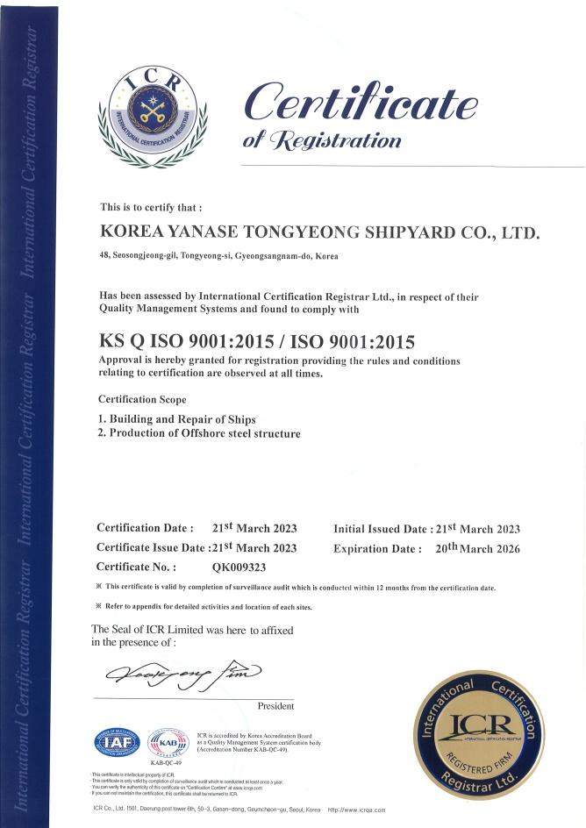
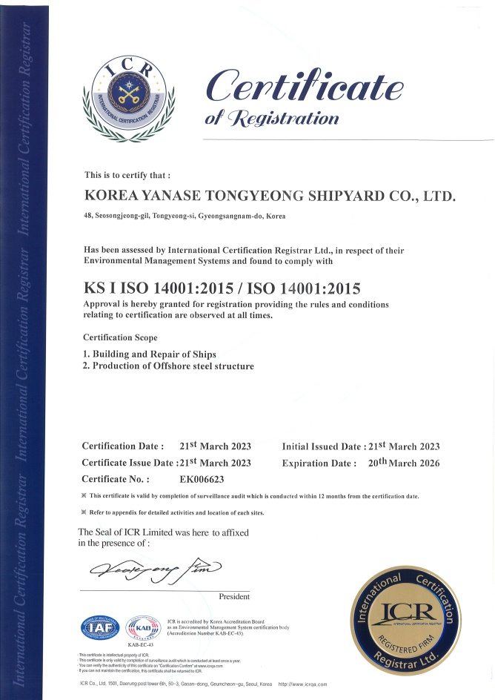
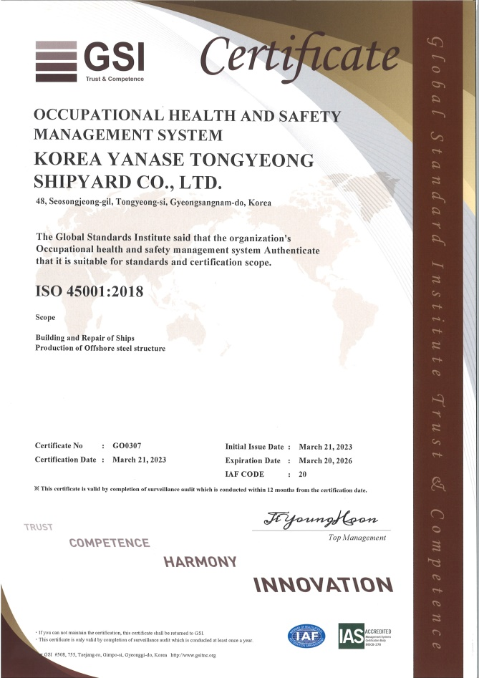
9. Certificate
Vision to the Future!

Slide 17
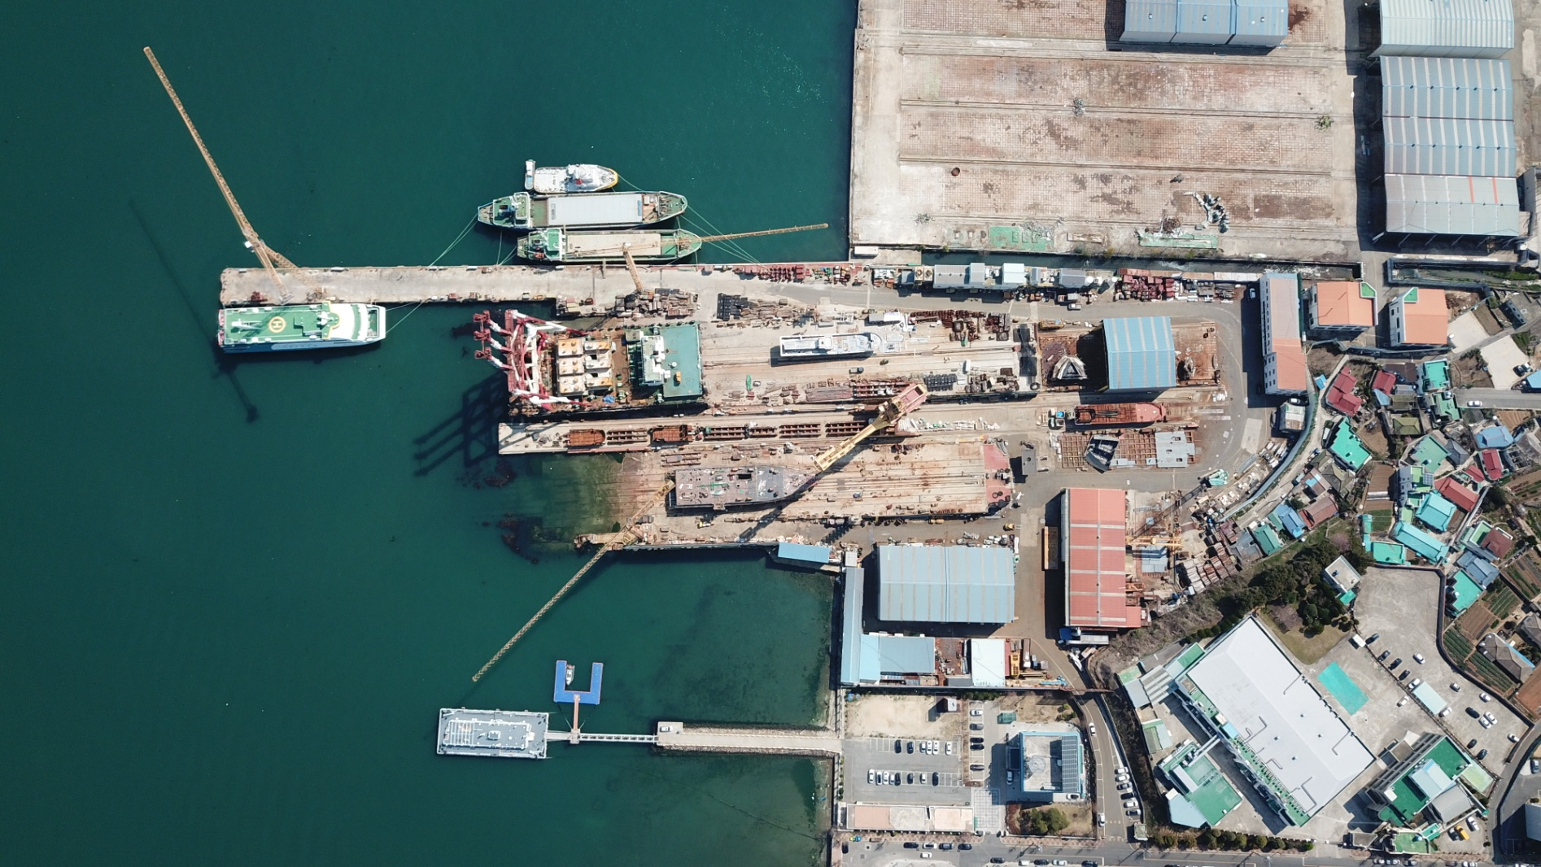
Corporate Information
Vision to the Future!

Slide 18
Corporate Information
KY Head Office
KYTS

Slide 19
THANK YOU
Vision to the Future!

